Slide 1
eCommerce Recommendation Engine
From Data to Personalized Product Suggestions
Arthur C. Flores Jr.
AIM AIML Capstone Project | Pillar 5
Dataset: Customer Shopping Trends (3,900 customers, 25 products)

Slide 2


Problem Statement
Business Problem
Data Science Problem
Generic "most popular" recommendations are shown to all customers regardless of their preferences
This fails to personalize the shopping experience so we will aim to increase Average Order Value (AOV) and customer retention
Opportunity: tailor recommendations to individual behavior and demographics to drive revenue
Given a user's demographic profile and product attributes, predict and rank the Top-K items they are most likely to purchase
Primary metric: NDCG@10 (Normalized Discounted Cumulative Gain)
Extends Precision and Recall (Module 4) to ranking-aware variants for evaluating recommendation quality
Dual framing ensures technical decisions are grounded in business outcomes

Slide 3
Data Overview & Key Challenges
3,900 rows × 18 columns
4 engineered features
Key Challenges
No date column
Temporal train/test split impossible, so we adapted to demographic-stratified random split
No text descriptions
Content-based filtering adapted to multi-hot encoding on Category, Size, Color, Season
Single transaction per user
Collaborative filtering expected to underperform which was anticipated and documented
Gender imbalance (68/32)
Flagged for Step 5 bias auditing from the outset
96% sparse
1 transaction per customer
68% Male / 32% Female
4 age groups
50 US states
25 products
Data quality: zero nulls, zero duplicates, zero outliers via IQR

Slide 4
Preprocessing & Feature Engineering
Encoding & Scaling
4 Engineered Features
spending_tier Purchase Amount binned into terciles
Raw amount didn't differentiate across segments (EDA-driven)
engagement_score Purchases + subscription + discounts
Standard CRM metric (domain-driven)
season_category Season vs Category interaction (16 combination)
Subtle seasonal patterns worth capturing (EDA-driven)
customer_maturity Previous Purchases (new / regular / loyal)
Lifecycle proxy since no date column (domain-driven)
Binary: Gender, Subscription Status, Discount Applied
Ordinal: Size (S=0 to XL=3), Frequency of Purchases
One-Hot: Category, Color, Season, Payment Method, Shipping Type
StandardScaler applied to all numerical and engineered features
Increased from 18 to 59 columns after encoding
Unified encoding pipeline serves all downstream models model types: distance-based, tree-based, collaborative, and content-based

Slide 5
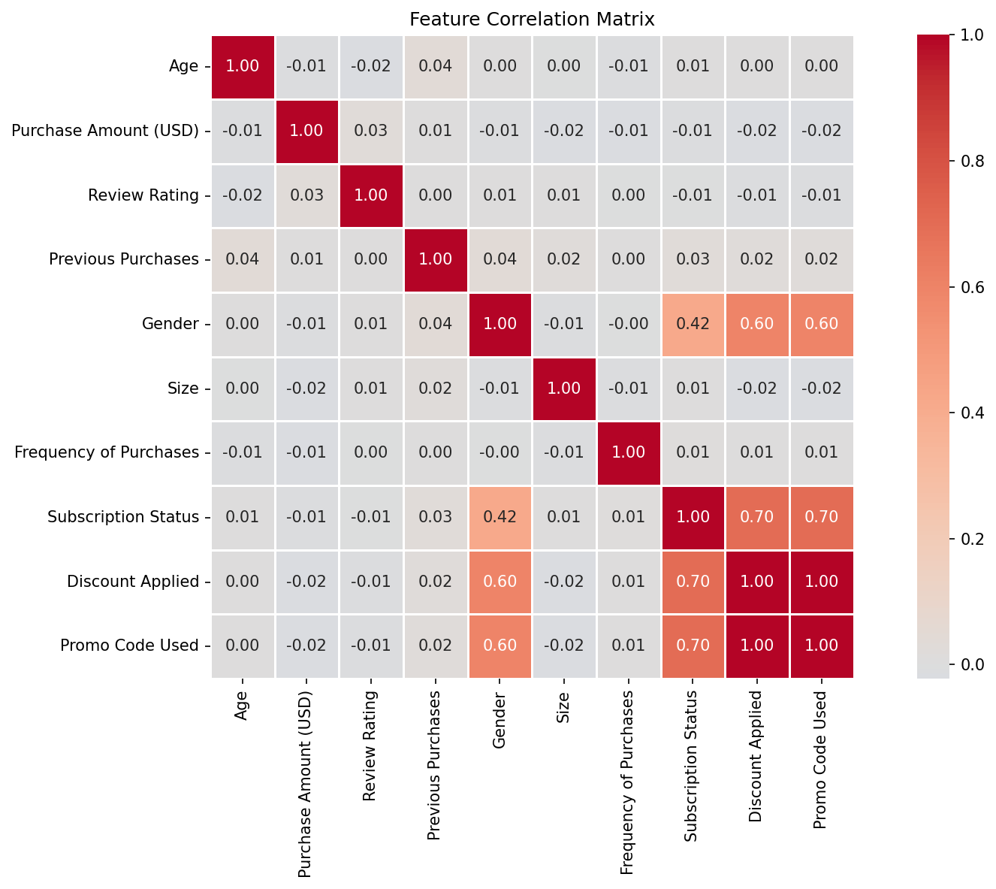
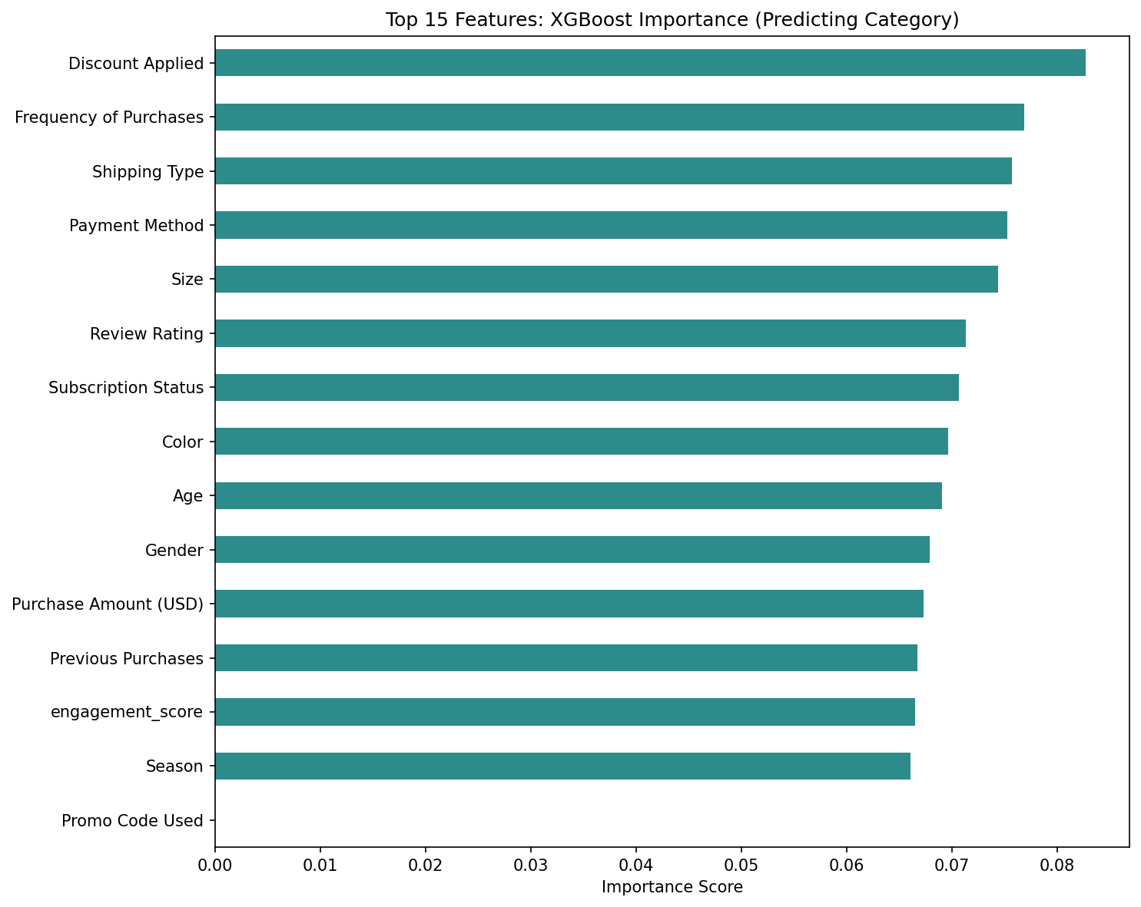
Preprocessing & Feature Engineering
Feature Selection
Dual method: Correlation filter and XGBoost embedded importance
Promo Code Used dropped since it is identical to Discount Applied (1.00 correlation) which is confirmed by zero feature importance
XGBoost feature importance showed flat distribution (0.066–0.083) which is consistent with a synthetic data

Slide 6
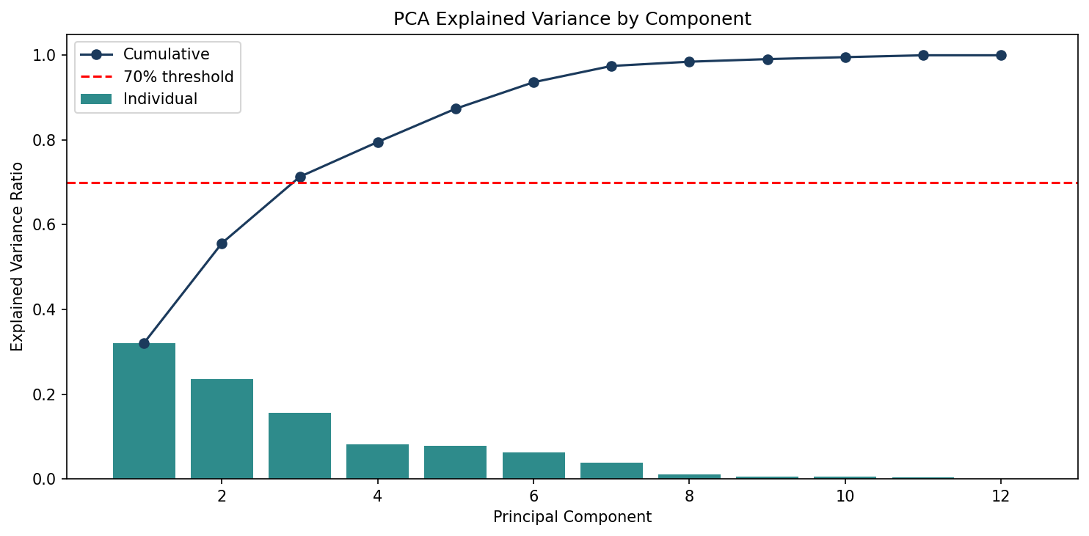
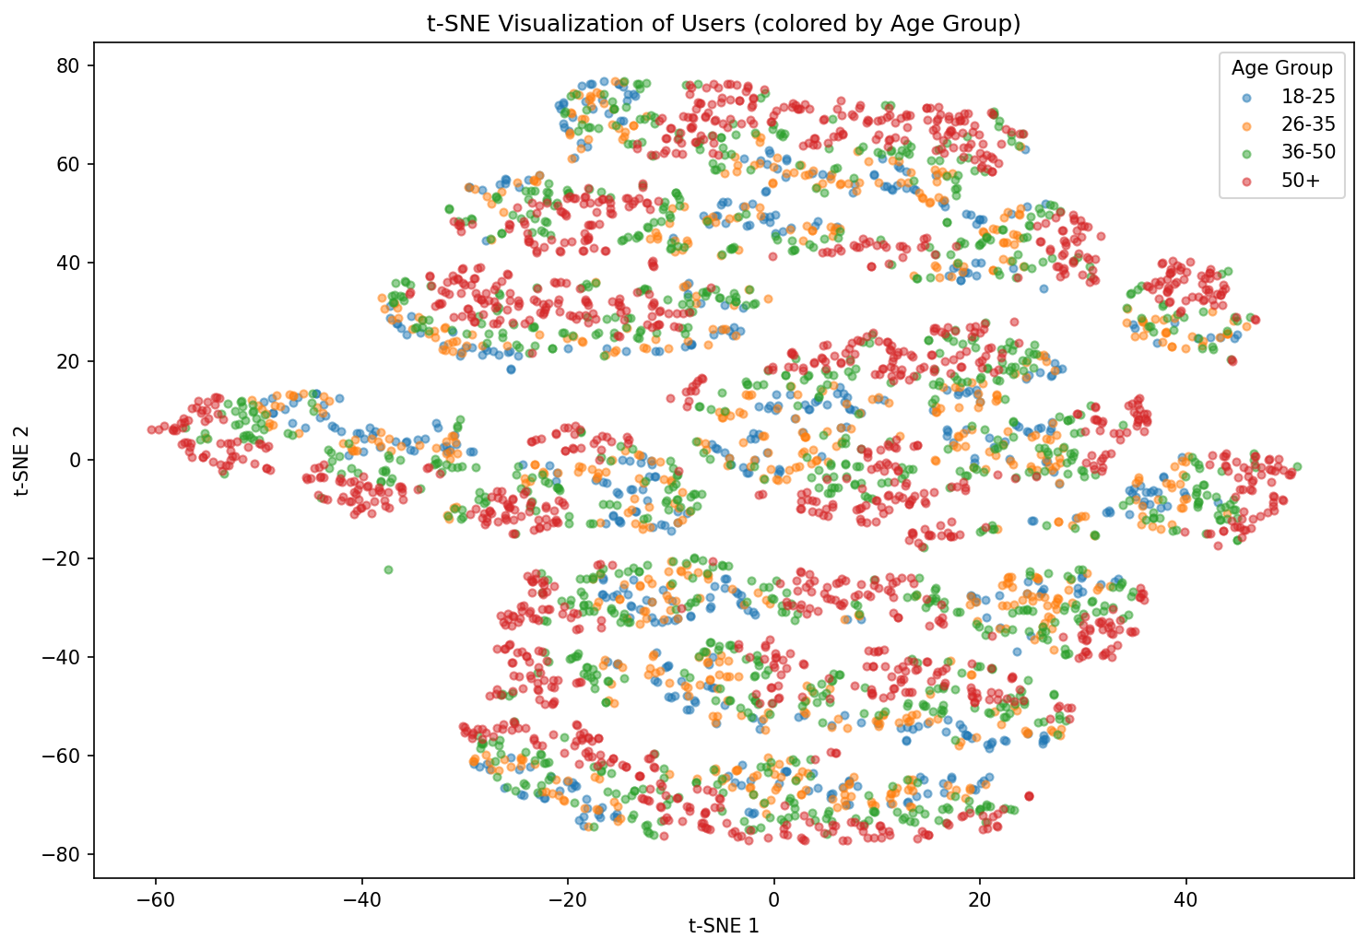
Dimensionality Reduction
PCA: 3 Components Capture 71.3% Variance
t-SNE: No Natural Age-Based Clusters
PC1 (32.1%): Frequency of Purchases (1.000)
Strongest single differentiator: “how often users shop”
PC2 (23.5%): Previous Purchases + engagement_score + customer_maturity
Shared loyalty dimension where engineered features load together as expected
PC3 (15.7%): Purchase Amount + spending_tier
Derived pair loading together confirms feature design
All four age groups overlap heavily in feature space; no distinct demographic clusters emerge
Banded structure driven by discrete feature combinations (frequency levels, spending tiers, maturity segments) and not demographics
Consistent with EDA, spending and rating patterns were similar across age groups
Key insight: Engineered features validated where derived pairs load on the same components, confirming feature design rather than just reducing dimensions
Key insight: User behavior matters more than demographics for segmentation
Users colored by age group:
No distinct clusters, behavior drives structure over demographics
3 components capture 71.3% of variance with diminishing returns beyond this point

Slide 7
Model Architecture & Comparison
5 Models Tested using NDCG@10 as the Success Metric
Key Findings
Model | NDCG@10 | vs Baseline
Model 1: Popularity Baseline | 0.163 | —
Model 2: K-Means Cluster (k=3) | 0.169 | +3.6%
Model 3: Collaborative Filtering | 0.163 | No lift
Model 4: Content-Based (Adapted) | 0.175 | +7.3%
Model 5: XGBoost Ranker | 0.176 | +7.9%
Collaborative Filtering matched baseline
Expected outcome: 96% sparse matrix meant most user pairs share zero purchases, reducing cosine similarity to near-identical scores
Content-Based required adaptation
Test users absent from training set, so we instead matched to similar demographic profiles to generate recommendations instead of relying on purchase history
XGBoost leakage discovered and removed
collab_score and content_score were derived from training labels (importance = 1.0) so both were removed from training and test inference
Narrow performance gap (0.163–0.176)
Expected with synthetic data where features are generated independently with limited natural separation
Note:
Model 5 was originally designed as a hybrid meta-learner, blending collab_score and content_score from Models 3 and 4
After both were removed due to data leakage, the model operates as a direct ranker using only user profile and item features.
The model was renamed from "XGBoost Hybrid" to "XGBoost Ranker" to reflect what was delivered
Tollgate Decision: Champion Model (XGBoost Ranker, NDCG@10: 0.176) outperforms the popularity baseline (0.163) by 7.9%

Slide 8
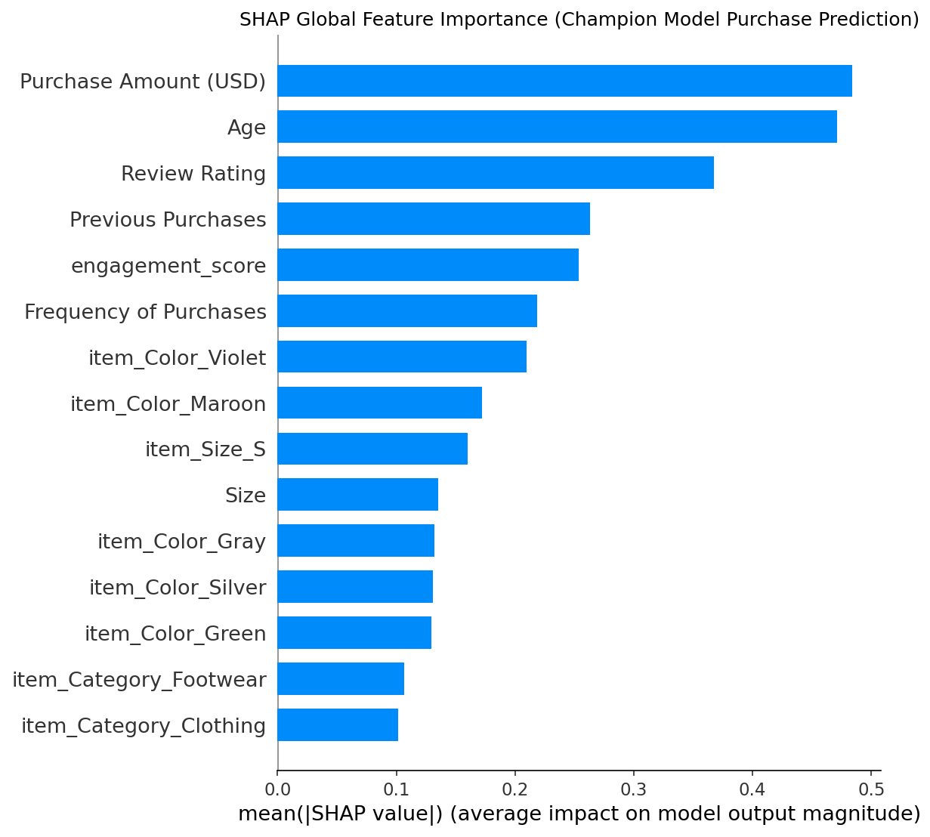
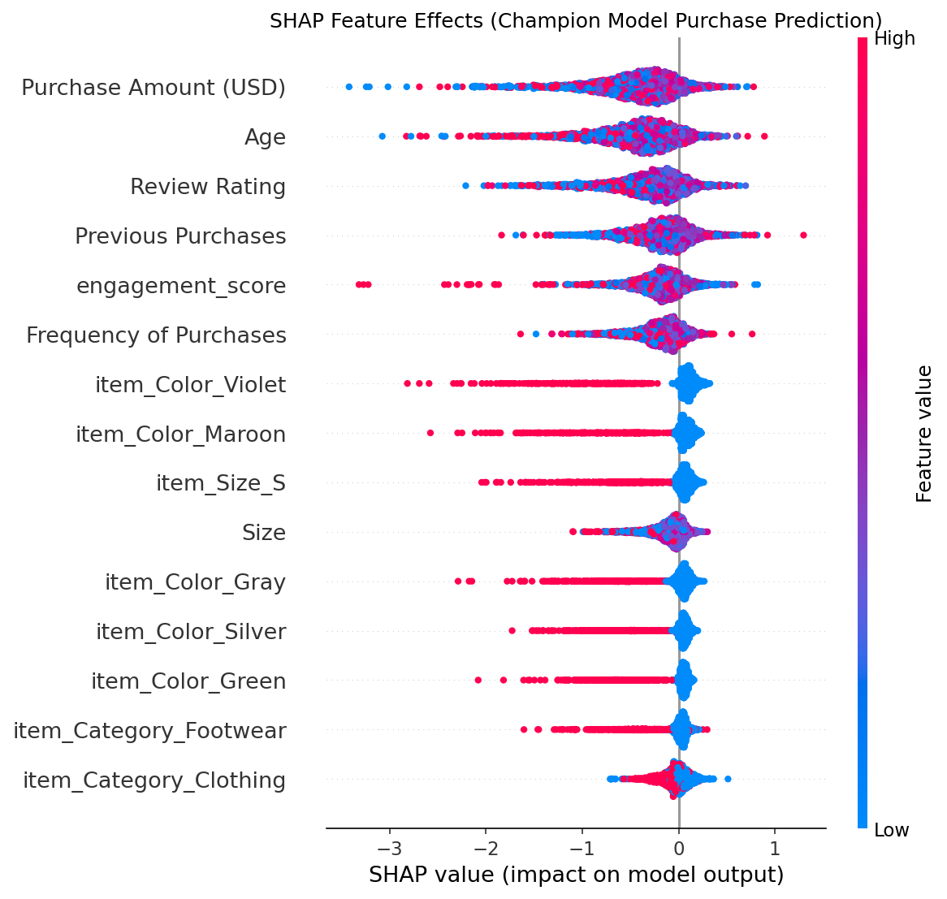
Model Explainability: SHAP
SHAP Global Importance
SHAP Beeswarm
Purchase Amount and Age are the top two features (mean |SHAP| 0.48)
Top 6 features are all user-level:
The model relies more on understanding who the customer is than what the product looks like
Purchase Amount and Age show wide, symmetric distributions
Both high and low values push predictions in either direction
No single feature dominates in one direction
The model makes interaction-based predictions, not a simple "more X = more likely to buy" rules
SHAP beeswarm: Champion model
The model uses Purchase Amount and Age to match users to items, not to uniformly boost or suppress predictions
SHAP global feature importance: Champion model
Gender, Subscription Status, and Discount Applied do not appear in the top 15 which is consistent with near-zero PCA loadings

Slide 9
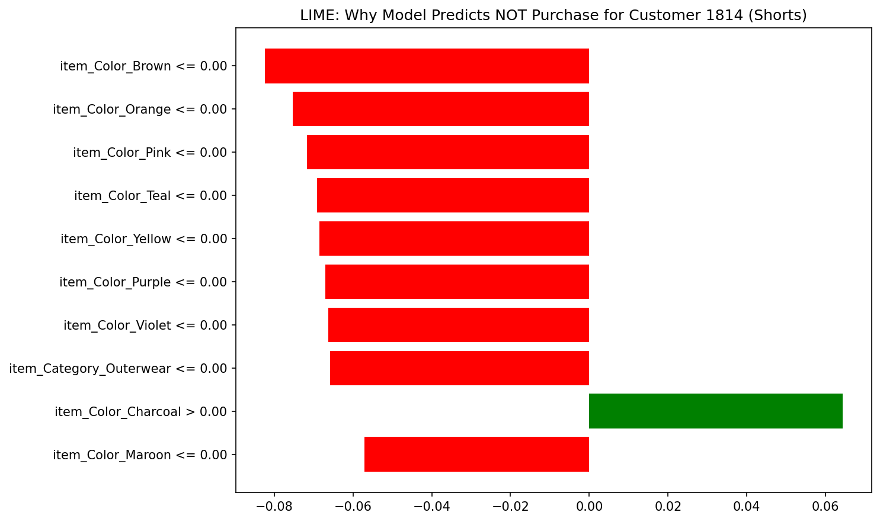
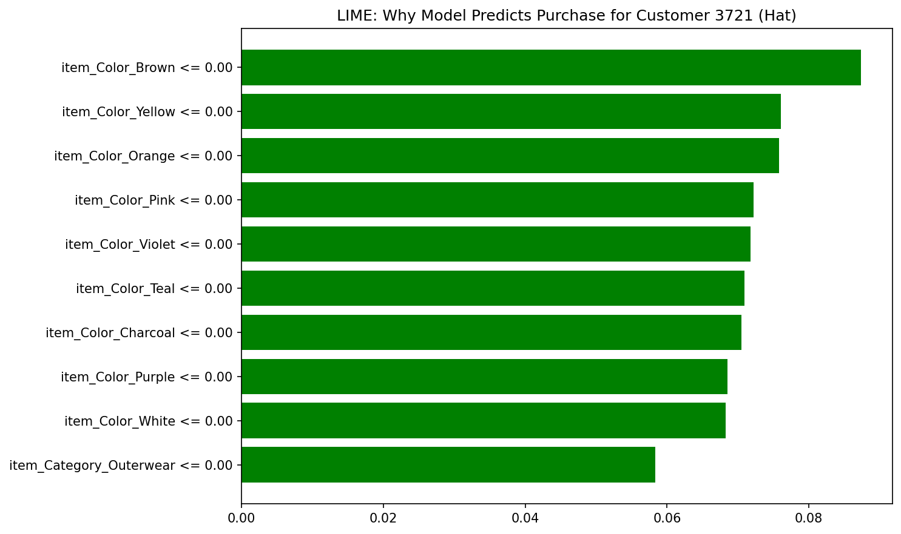
Model Explainability: LIME
Example 1: Customer 1814 - Shorts
Example 2: Customer 3721 - Hat
P(purchase) = 2.1% which predicted NOT purchase
Absence of multiple colors (Brown, Orange, Pink, Teal, Yellow) pushed strongly toward non-purchase
This item's color profile does not match what similar users purchased in training
P(purchase) = 66.2% which predicted purchase
Absence of Brown, Yellow, Orange pushed toward purchase which is an opposite direction from Example 1
LIME explanations are local, so the same condition (e.g., "not Brown") means different things depending on user profile and item type
Key insight:
LIME explanations are dominated by item-level features (color, category), while SHAP global analysis shows user features ranked highest
While SHAP measures average impact across all predictions, LIME, on the other hand, zooms in on why a single result was chosen
Essentially, once a user's profile filters the options, specific item details are what trigger the final individual prediction

Slide 10
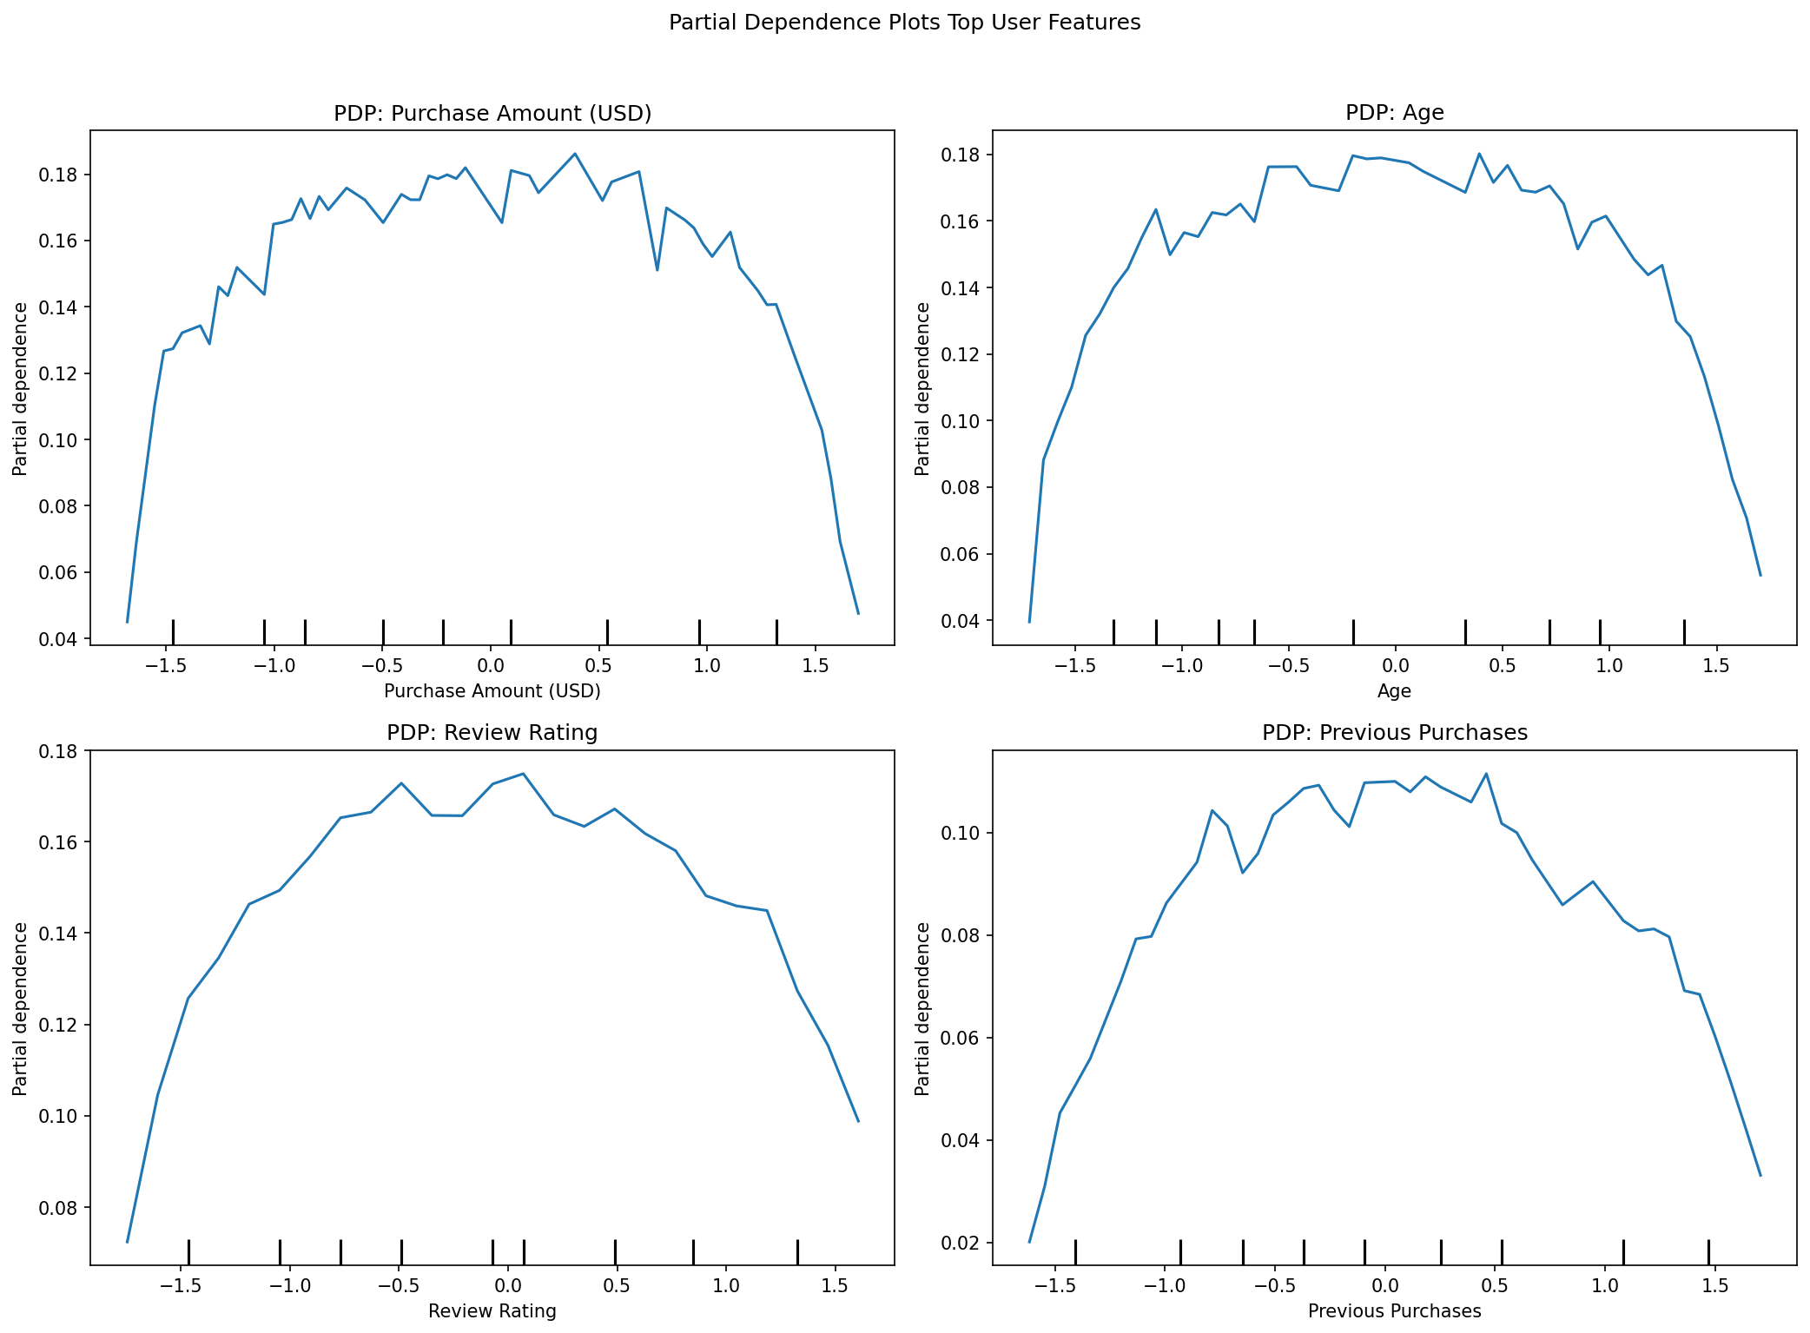
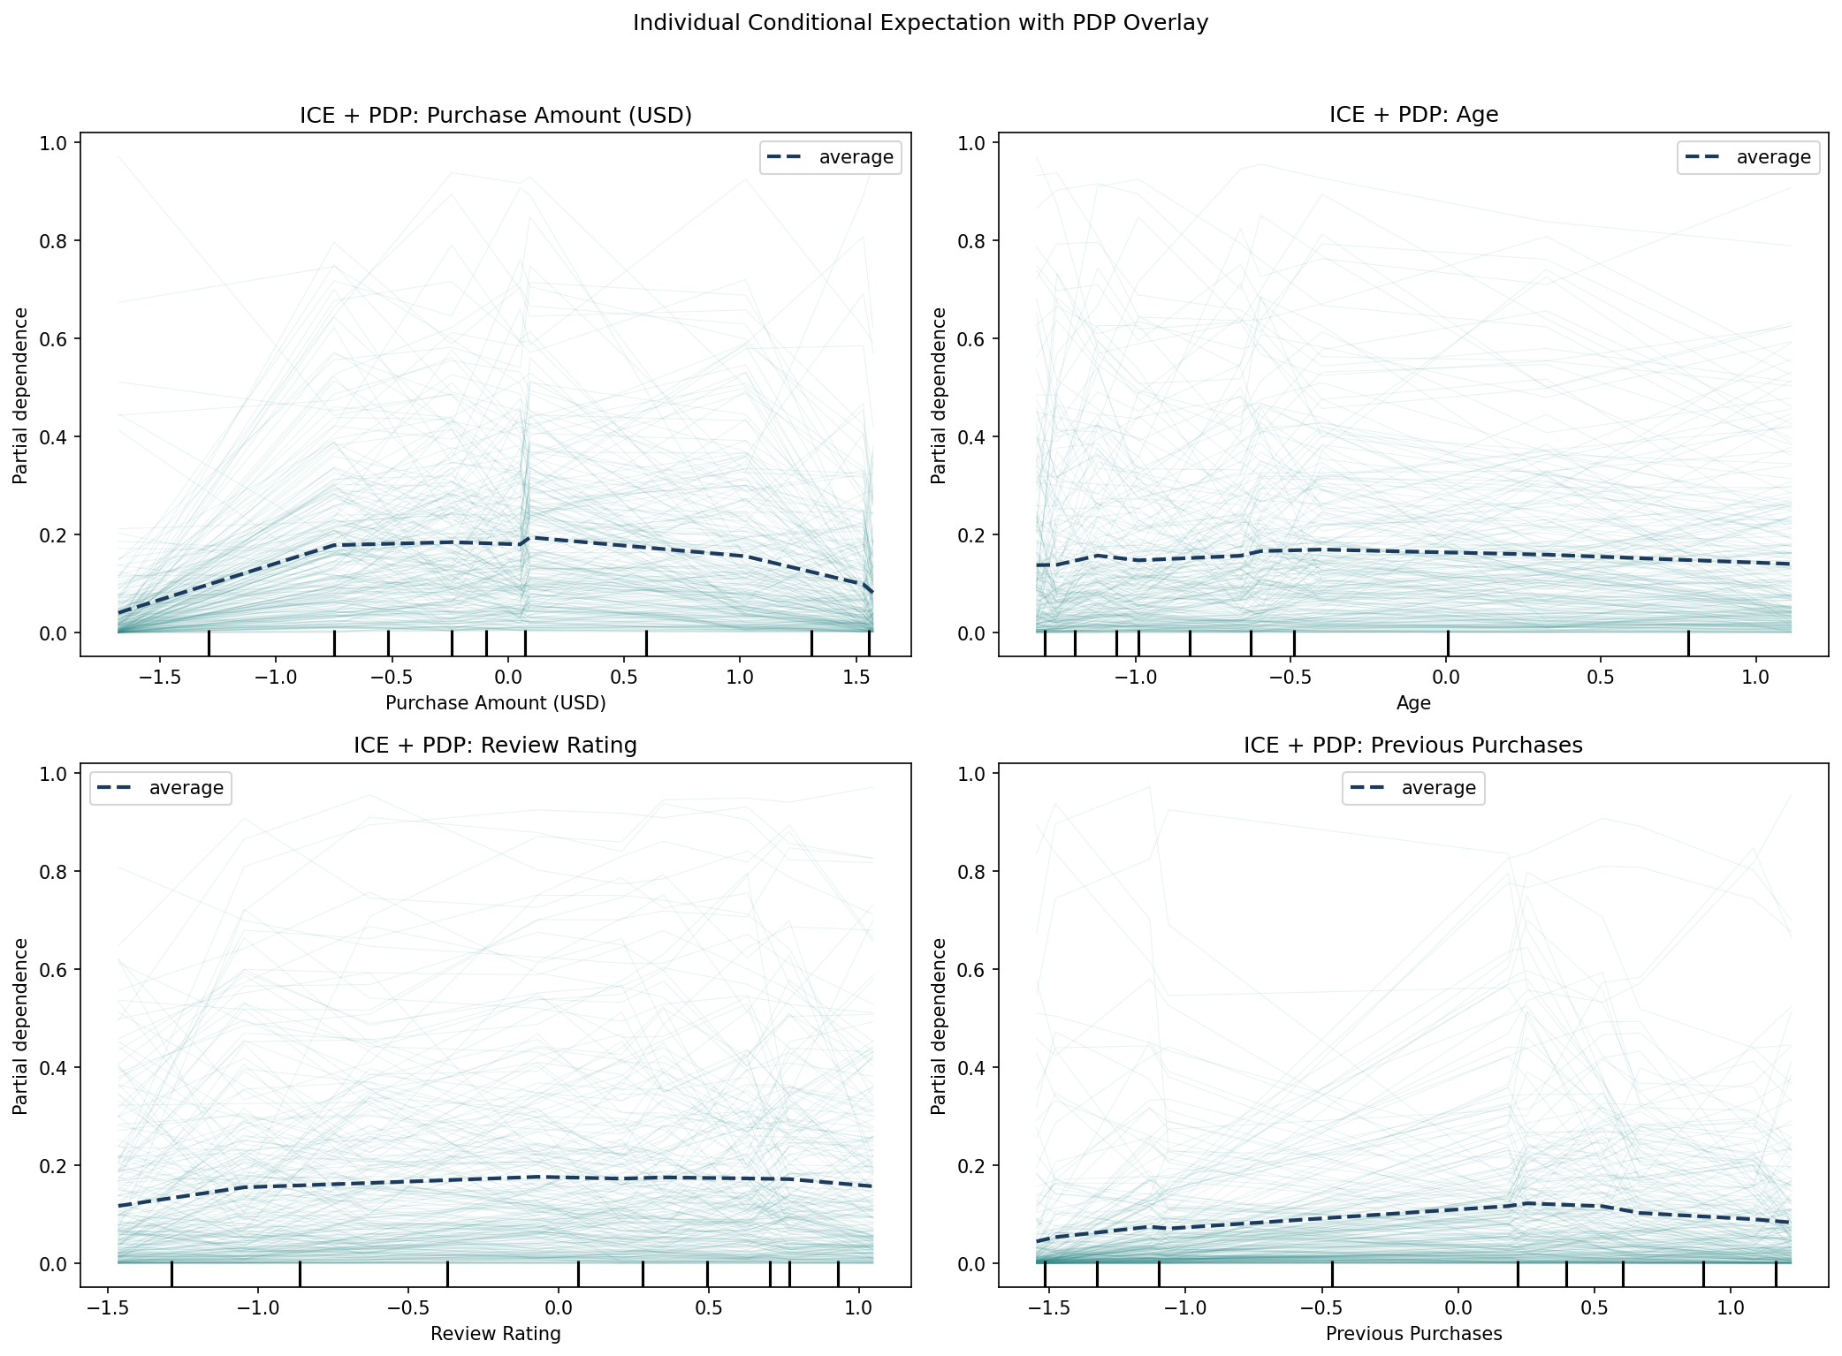
Model Explainability: PDP & ICE
Partial Dependence Plots (PDP)
Individual Conditional Expectation (ICE)
All four top features show an inverted-U pattern:
Purchase probability peaks in the mid-range, drops at both extremes
Implication for bias: if any demographic group concentrates at the extremes, they may receive lower-quality recommendations
Majority of ICE lines cluster near zero (non-purchase) which is expected with 96% negative user-item pairs
A small subset spike sharply upward (0.6 to 1.0) for well-matched user-item pairs which drive the actual recommendations
Inverted-U across all four features:
The model is best for
mid-range users
The PDP average masks this heterogeneity:
Sharp spikes for well-matched pairs hidden by PDP average
It blends confident matches with near-zero predictions
Key insight:
Instead of giving weak predictions across the board, the model delivers confident scores for strong matches and near-zero results for everything else
This is an expected behavior of a recommendation engine where it is decisive for good matches while cautious for poor ones

Slide 11
Bias Audit & Fairness Metrics
Fairness Metrics Summary
Threshold: 4/5 rule (Disparate Impact >= 0.80)
Originates from US EEOC employment guidelines, adopted as baseline benchmark for this project
Group | Best NDCG@10 | Worst NDCG@10 | Gap | DP Difference | Disparate Impact | Assessment
Gender | Male: 0.186 | Female: 0.157 | 15.5% | 0.056 | 0.864 | Marginal bias
Age Group | 36-50: 0.181 | 18-25: 0.171 | 5.5% | 0.018 | 0.955 | No bias
Spending Tier | High: 0.196 | Low: 0.166 | 18.1% | 0.065 | 0.846 | Bias detected
Gender (68/32 split)
Age Group
Spending Tier
Male users receive better recommendations due to having roughly twice the training examples
Gender's correlation with Subscription Status (0.42) and Discount Applied (0.60) amplifies disparity through indirect pathways
No systematic age-based disadvantage as all groups are within 0.171 to 0.181 range
Smallest group (18-25: n=114) performs comparably to the largest (50+: n=296)
Consistent with PCA:
Age loaded on PC4 (7.9% variance) was not a major model driver
Largest disparity: high spenders (0.196) vs low spenders (0.166) has 18.1% gap
Consistent with PDP: model performs best in mid-to-high Purchase Amount range
Business trade-off decision is to either:
optimize for high-value customers or serve all segments equally
Note: Race/Ethnicity is not available in dataset:
This is documented as a limitation
Production systems should collect and audit across racial groups with appropriate consent

Slide 12
Mitigations & Next Steps
Gender Disparity (DP: 0.056)
Spending Tier Disparity (DP: 0.065)
Resampling: Oversample Female users from 1,248 to 2,600 to match Male representation
Reweighting: Assign higher sample_weight to Female users during XGBoost training (same effect without altering the dataset(
Post-processing re-ranking: Adjust Female recommendation scores upward by 13.6% calibration factor
Feature auditing: Test removing or decorrelating Subscription Status and Discount Applied to reduce indirect gender pathways
Threshold adjustment: Lower confidence threshold for low-spend users to surface relevant items even under uncertainty
Data augmentation: Enrich low-spend profiles with browsing history and wishlist data in production
Business policy decision: If prioritizing high-value customers is intentional, document as a deliberate choice with explicit fairness trade-off acceptance
Production Monitoring & Governance
Monthly fairness monitoring: Compute DP and DI ratios monthly with automated alerts if DP exceeds 0.05 or DI falls below 0.80
A/B testing: Run controlled experiments before deploying mitigations to measure trade-off between fairness and NDCG@10
Race/ethnicity inclusion: Add to fairness audit pipeline when data collection policies allow
Feedback loop awareness: Monitor for cycles where underserved groups disengage, worsening disparity over time
All mitigations are proposed (none alter the current model results). Implementation requires A/B testing and business alignment before deployment.

